Slide 1
Whitman Poem

Slide 2
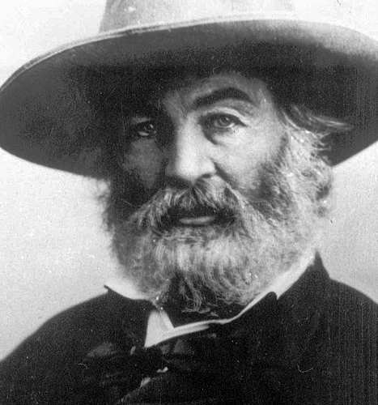
DIRECTIONS
You have already illustrated a line of poetry and paraphrased it into simpler language. Now, you are going to tell the story of the illustrations on the following slides before we then look to see the actual poem. Look to image 3; write in that character’s POV using 1st person as you complete your paraphrase sheet. Also, consider tone.

Slide 3
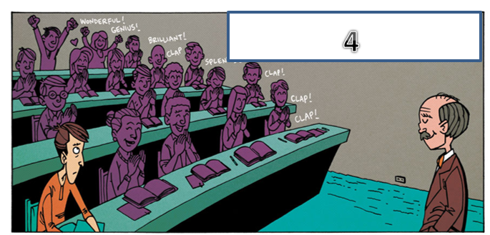

Slide 4
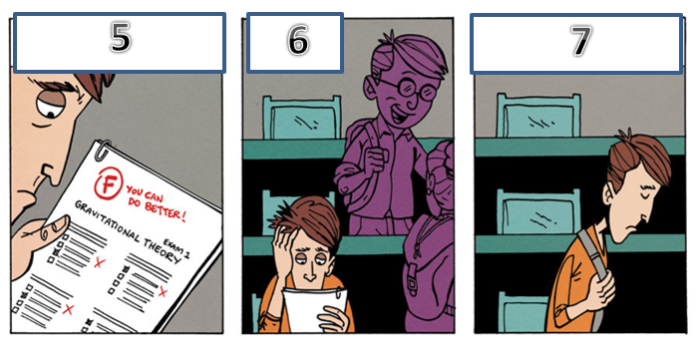

Slide 5
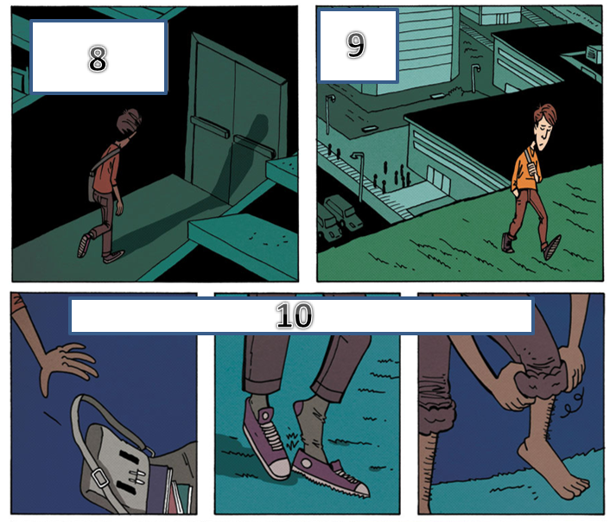

Slide 6
